Slide 1
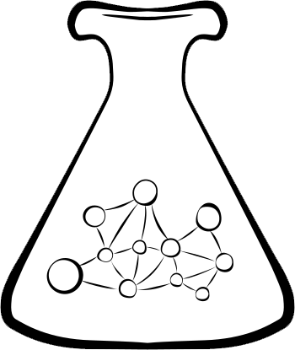
Spritely
Networked
Communities
Institute
Plurality Research Network Conference
January 13th-15th 2023
Notes:
[Host] Hi! We’re here! We’ve got something big to share, and we want your help!

Slide 2
This is a lightning talk, so it is given that:
Centralized Social Media is Busted
We are all here looking forward to individual-empowered safe online communities. We formed a non-profit to help with just that!

Slide 3
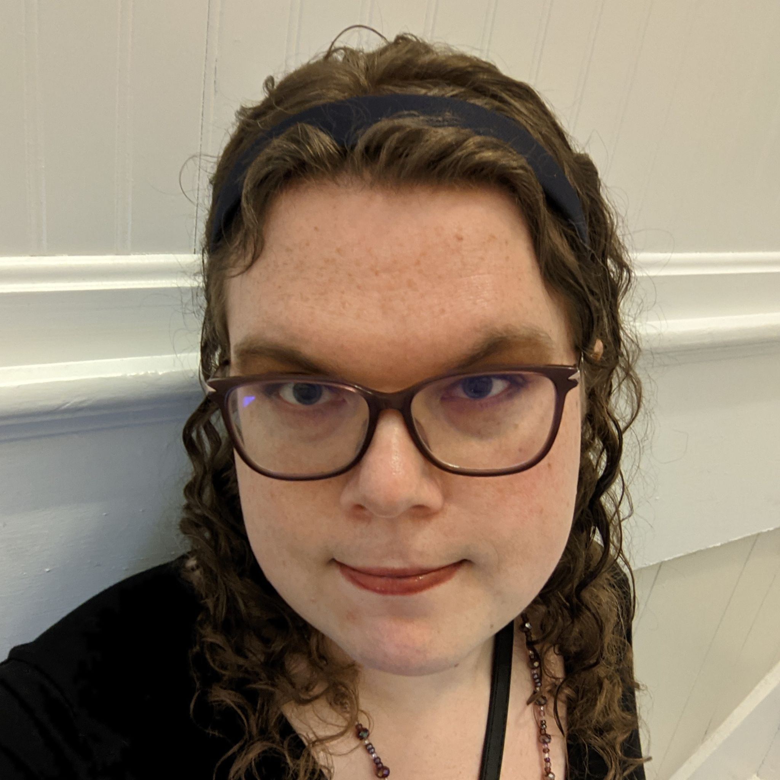
Spritely Institute Founders
Christine Lemmer Webber - Open & Social
ActivityPub, The Spritely Project, MediaGoblin
Randy Farmer - 40+yrs Social Platforms
Electric Communities, Avatars, E, JSON

Slide 4
Spritely Institute Founders
Christine Lemmer Webber - Open & Social
ActivityPub, The Spritely Project, MediaGoblin
Randy Farmer - 40+yrs Social Platforms
Electric Communities, Avatars, E, JSON

Slide 5
The ActivityPub standard
is great for
federated message sharing.
The ActivityPub standard
enables
“follow” networks, like Mastodon.
Notes:
“It’s been so successful” and “I’m proud to have worked on it.” - or some such

Slide 6
ActivityPub Alone Isn’t Enough
Content survival
Identity migration
Better privacy & security
Stronger anti-abuse & anti-harassment
Context confusion
Richer interactions
Notes:
The ActivityPub standard, alone, isn’t enough.

Slide 7
Disclaimer
What this talk is NOT about:
Changing the ActivityPub standard
“Fixing” Mastodon, or other social apps

Slide 8
Our Focus:
Re-Decentralize
Networked Communities
Notes:
We need to get back to our roots: building on the local community structures we have understood for millenia.
We need to re-decentralize networked communities - and we’re going to describe how to do that.

Slide 9
A new foundation:
Secure and distributed is the default
Your applications
represent you

Slide 10
Our social-stack of objects:
People
Identity, Relationships, Connections
Communities
Contexts, Memberships, Moderation
Applications
Security, Trust, Consent -> Commerce
No Gatekeepers Required
Notes:
On top of these secure objects, we’ll create open standardized objects to manage people’s identity and connections, community posts and governance, and general support for applications of all kinds.
There will be no centralized gatekeeper of any of these core objects, but individuals are free to decide to delegate authority to various services - Such as many people now “Login with Facebook”.

Slide 11
Mock Demonstration
Notes:
[Christine]
What follows is an aspirational sketch of a planned functional future demonstration of the platform.
Much of what you see here has been either implemented or bench-tested previously. This is the first time we try to put it all together.

Slide 12
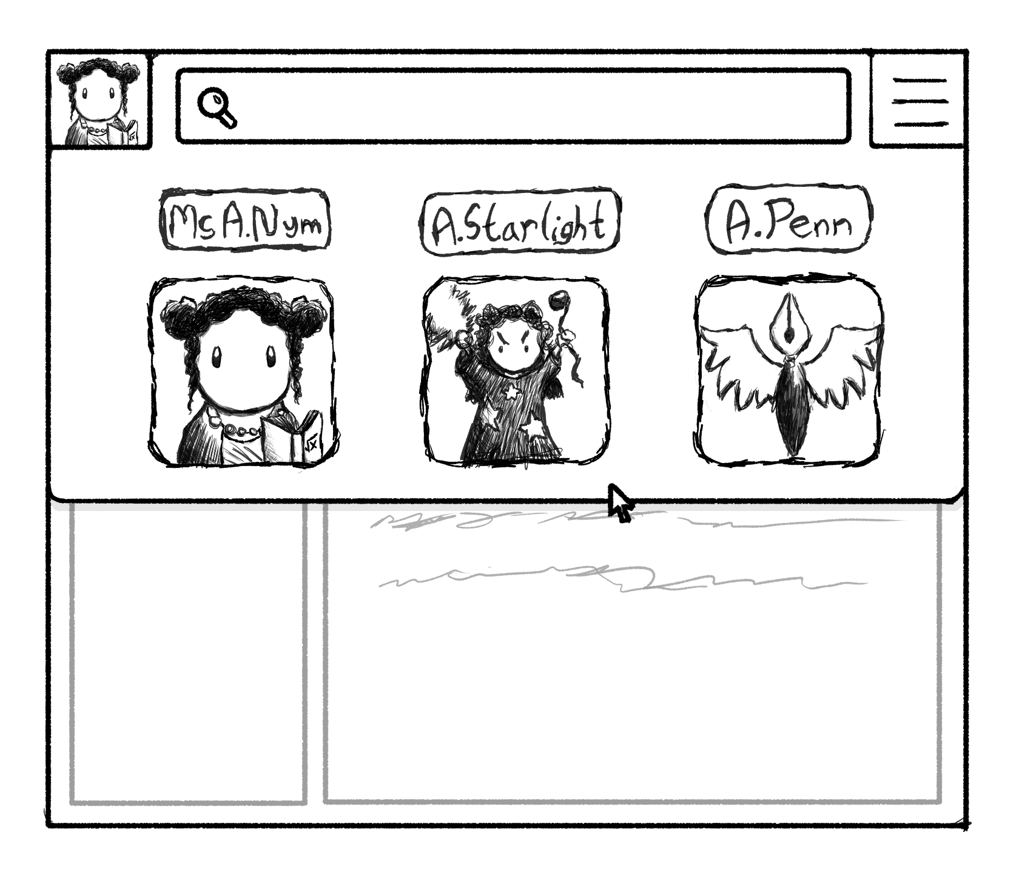
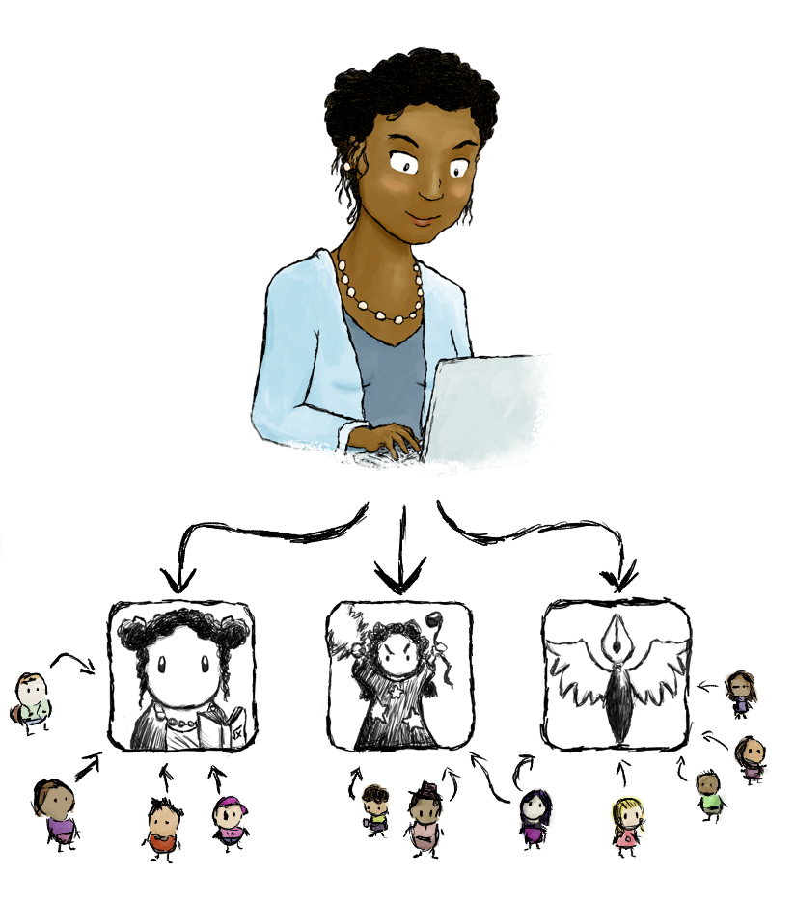
Notes:
We have a half our long mockup walkthrough that explains many of the features of our new decentralized world through the eyes of a teacher, game-player, and fan-fiction writer we’ve named Alicia…
(see me if you'd like a walkthrough…)

Slide 13
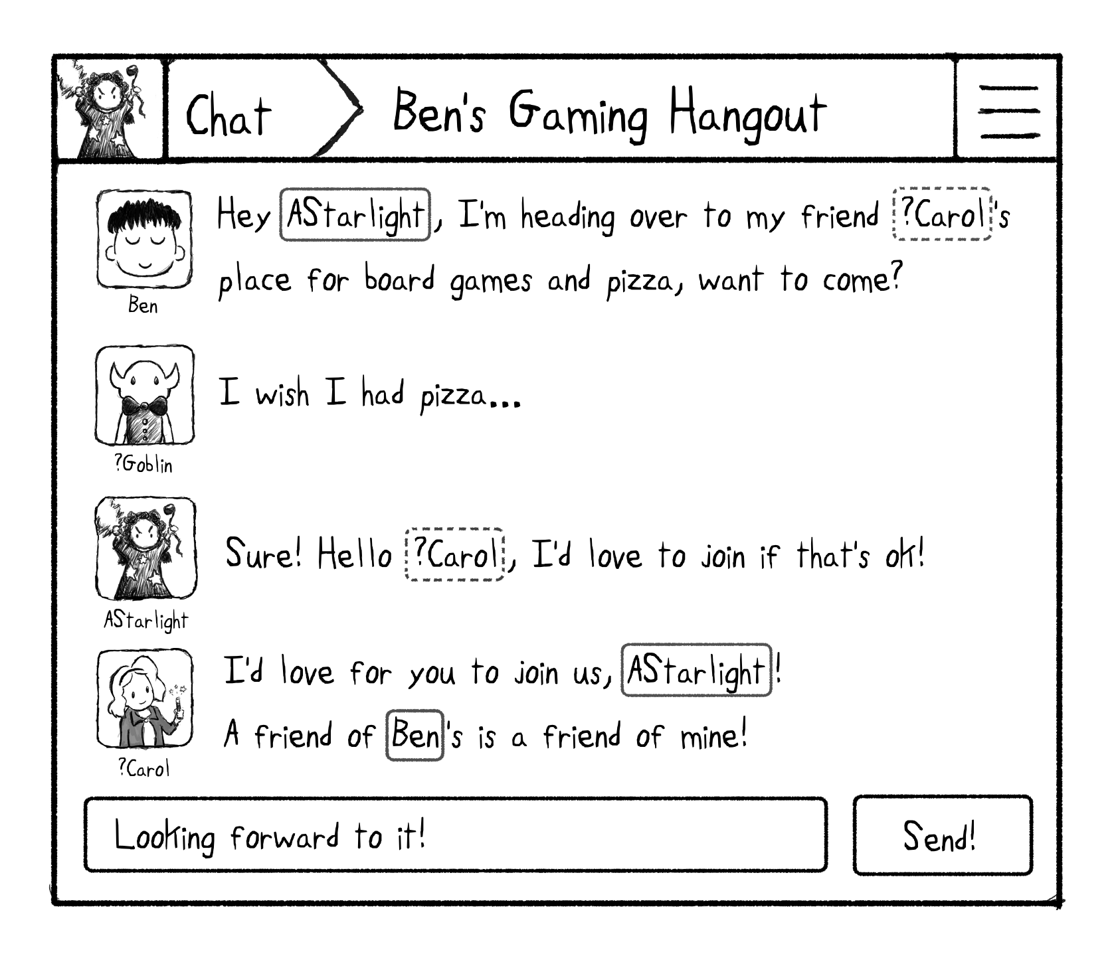

Slide 14
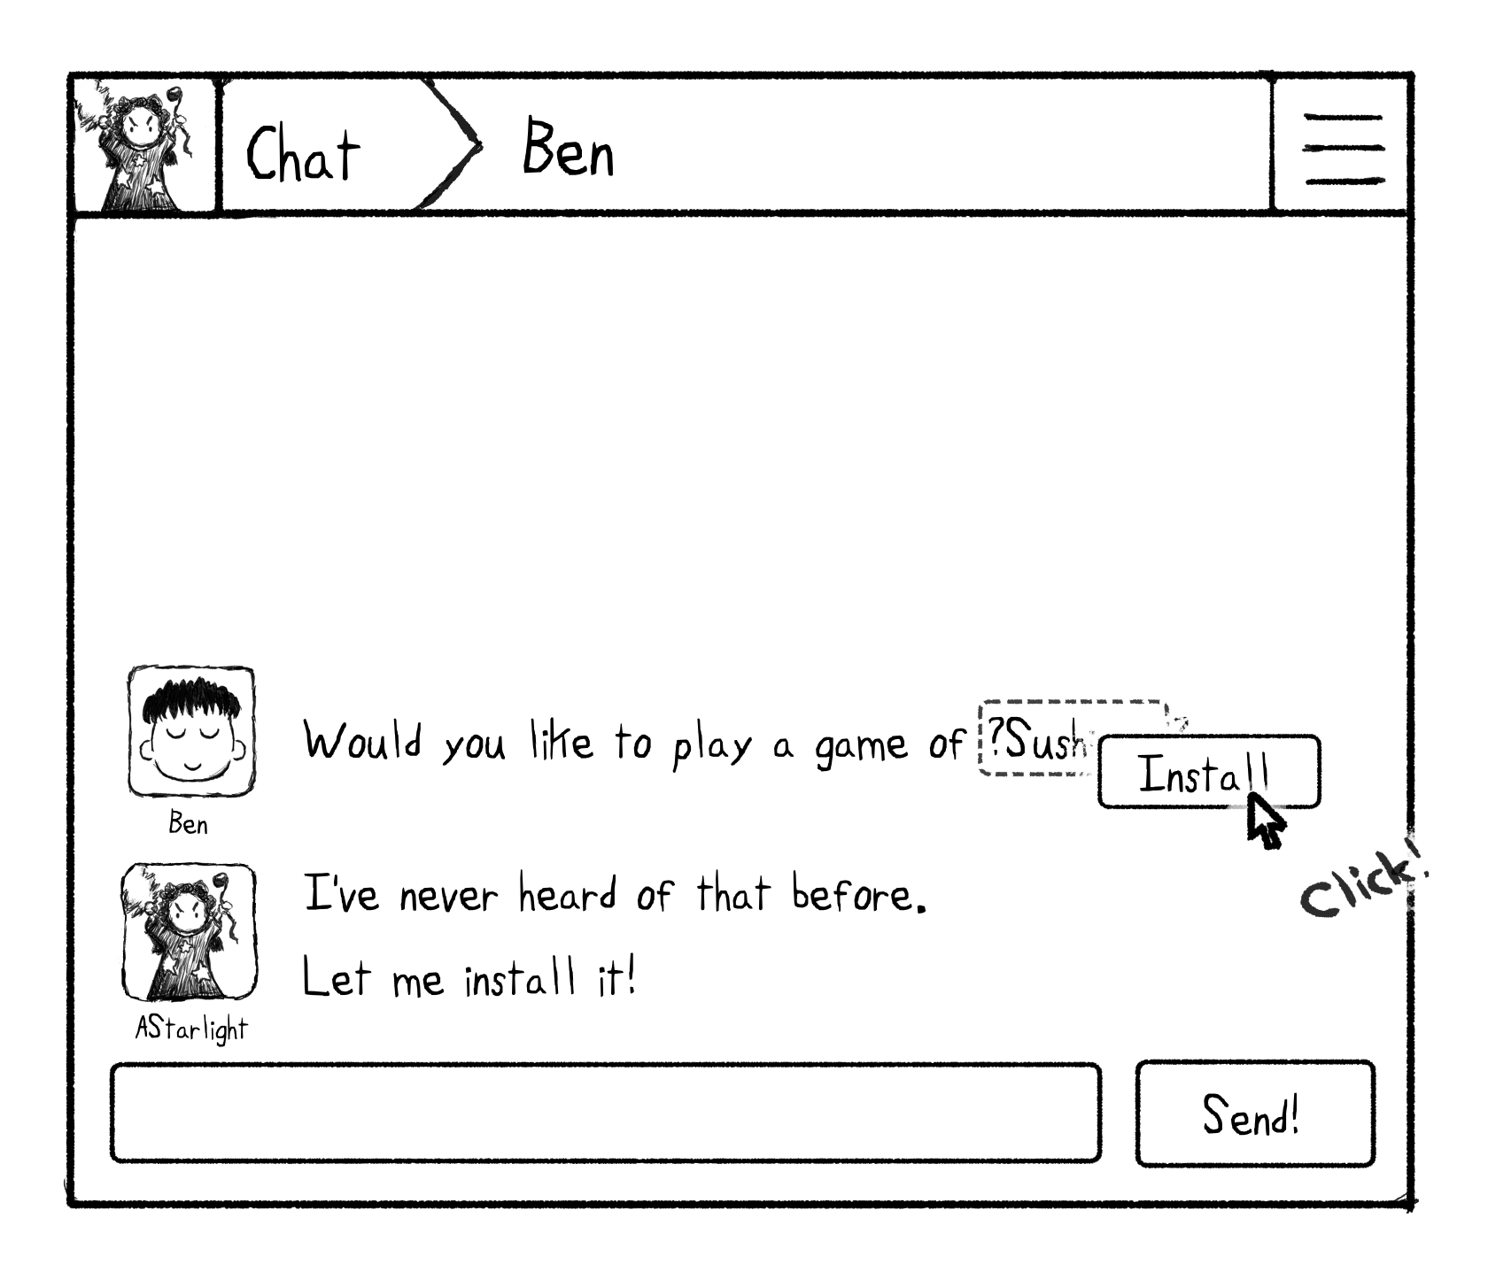
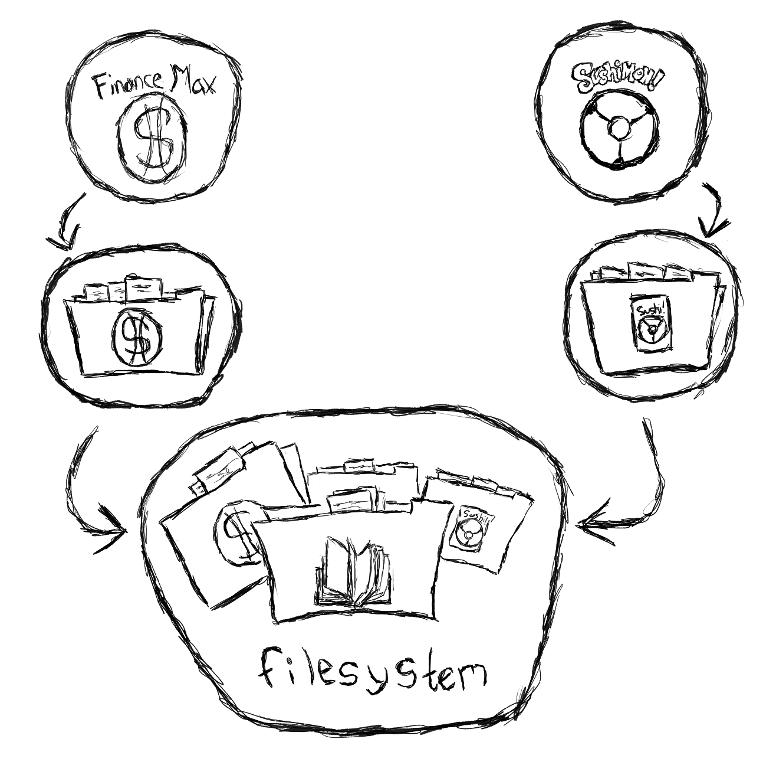
Notes:
Alisha clicks to install Sushimon on her computer. Wait… whaaaat? Isn’t installing an application straight from a chatroom link counter to everything we’ve been taught about good security? What if Sushimon wanted to steal all of Alisha’s financial documents?
The good news is: unlike in other systems, installing Sushimon is safe. Sushimon does not run “as Alisha”... it cannot automatically do all the things Alisha can do. Instead, Sushimon is given access to a restricted part of the filesystem, just for Sushimon, so it can’t access Alisha’s financial information. Alisha’s financial application similarly has access to its own files, but not Sushimon’s… this means that even if Alisha has shared her financial application access with her accountant, her accountant won’t know that Alisha likes to play Sushimon!

Slide 15
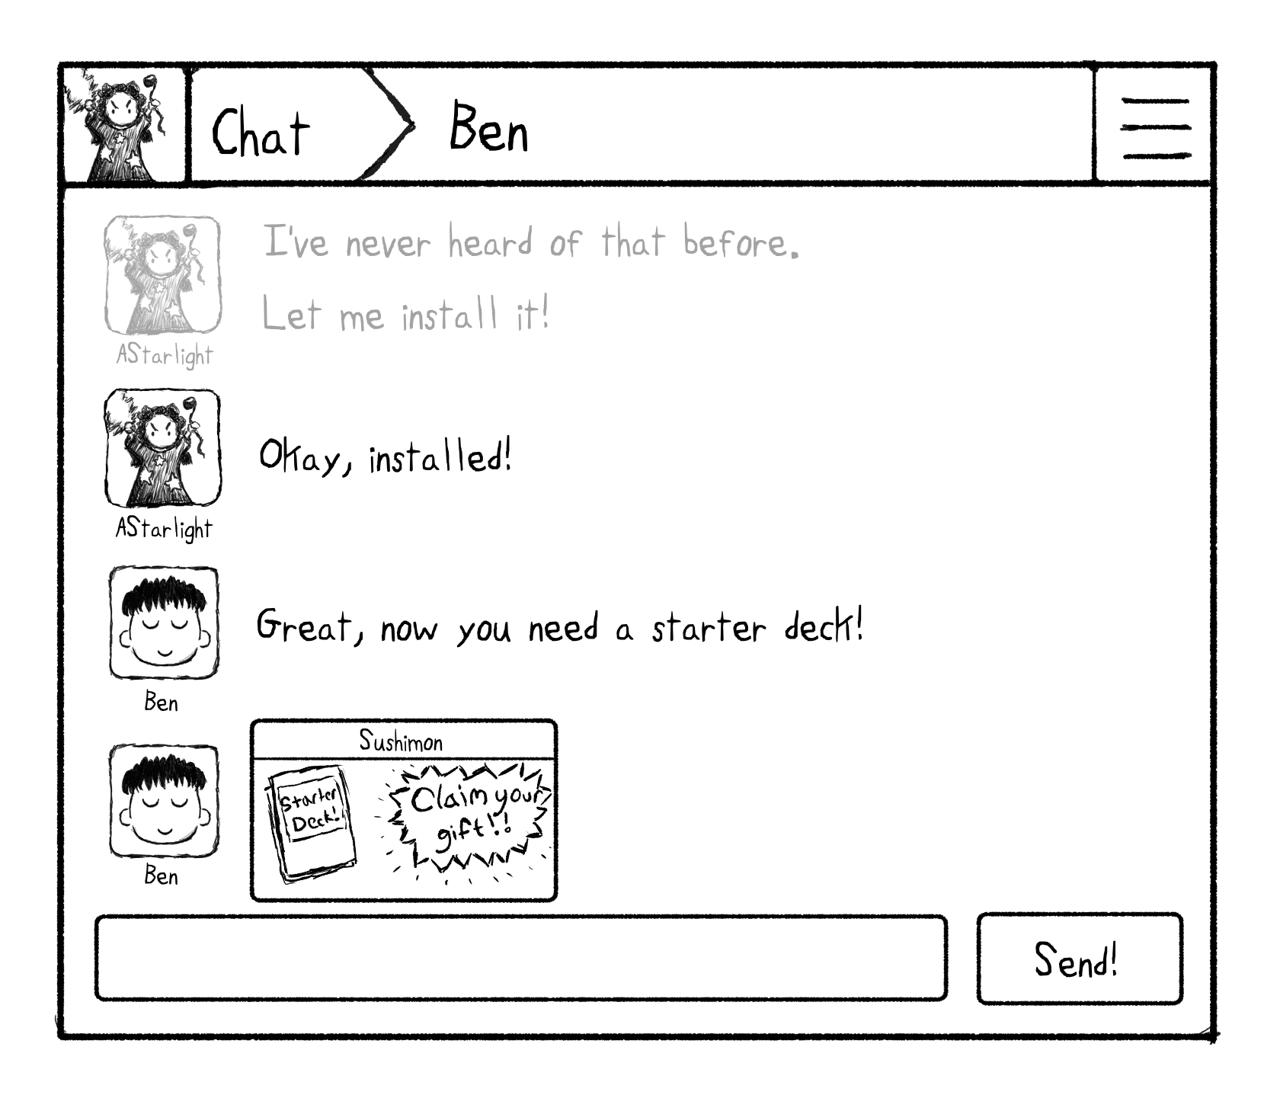
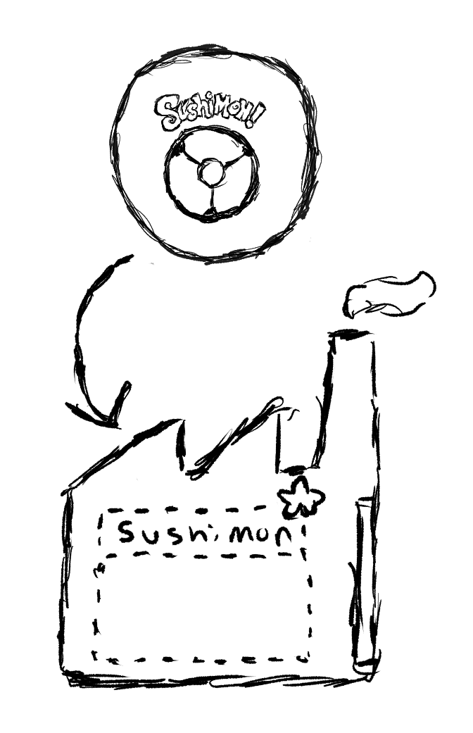
Notes:
Now that Alisha has Sushimon installed, Ben offers Alisha a starter deck. Sushimon is able to collaborate with the chat program so that Sushimon can embed a convenient app-widget for this operation. However, the “widget factory” that Sushimon gets access to ensures that any widgets that Sushimon will make are clearly identified as coming from Sushimon, preventing programs from masquerading as each other.

Slide 16
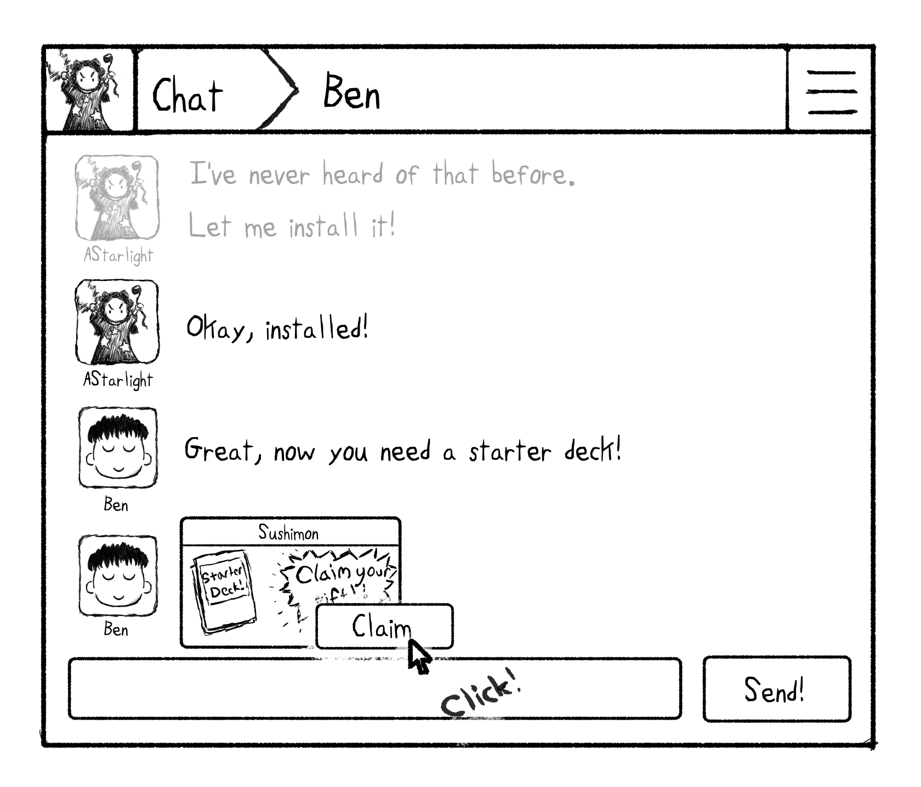
Notes:
Alisha can click on the widget and select the claim action directly, causing the transfer of the deck to her game inventory...
This is full app-within-an-app functionality!

Slide 17
What does the agency do for Alisha?
Contexts and personas
Mechanisms of consent
Decentralized naming
Robust commerce and trade
Safe, cooperative apps
Notes:
So - what does that demo show about what the agency does for Alisha?
Contexts and personas
Mechanisms of consent
Decentralized naming
Robust commerce and trade
Safe, cooperative apps

Slide 18
(progress report)

Slide 19
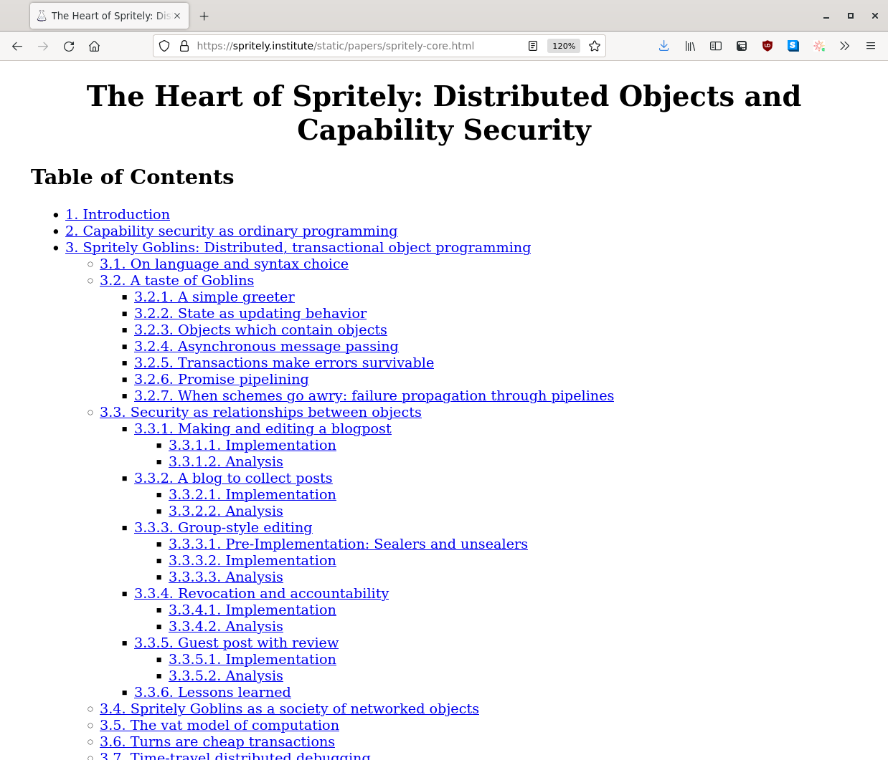
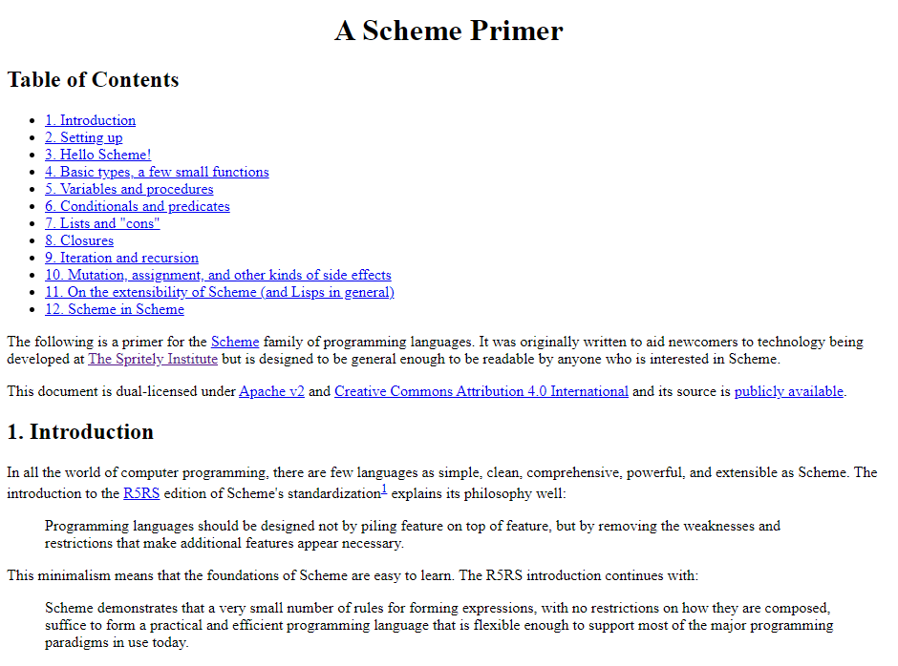
Papers, Platforms, Developers (Oh My)
Notes:
Papers,
Platforms
Developers,
OH MY!

Slide 20
Papers, Platforms, Developers (Oh My)
Notes:
Papers,
Platforms
Developers,
OH MY!

Slide 21
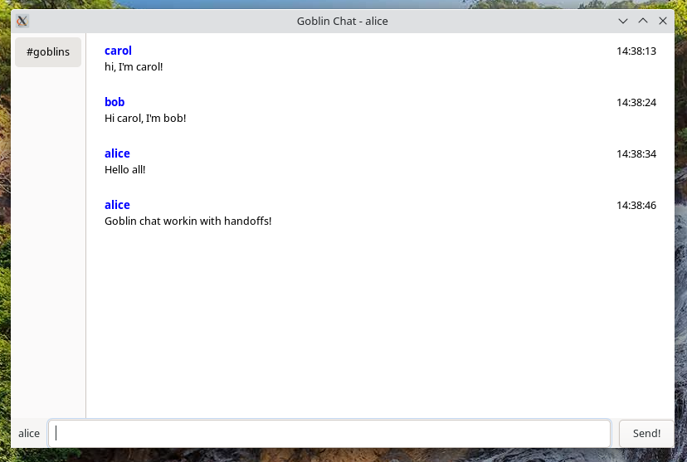
Papers, Platforms, Developers (Oh My)
Notes:
Papers,
Platforms
Developers,
OH MY!

Slide 22
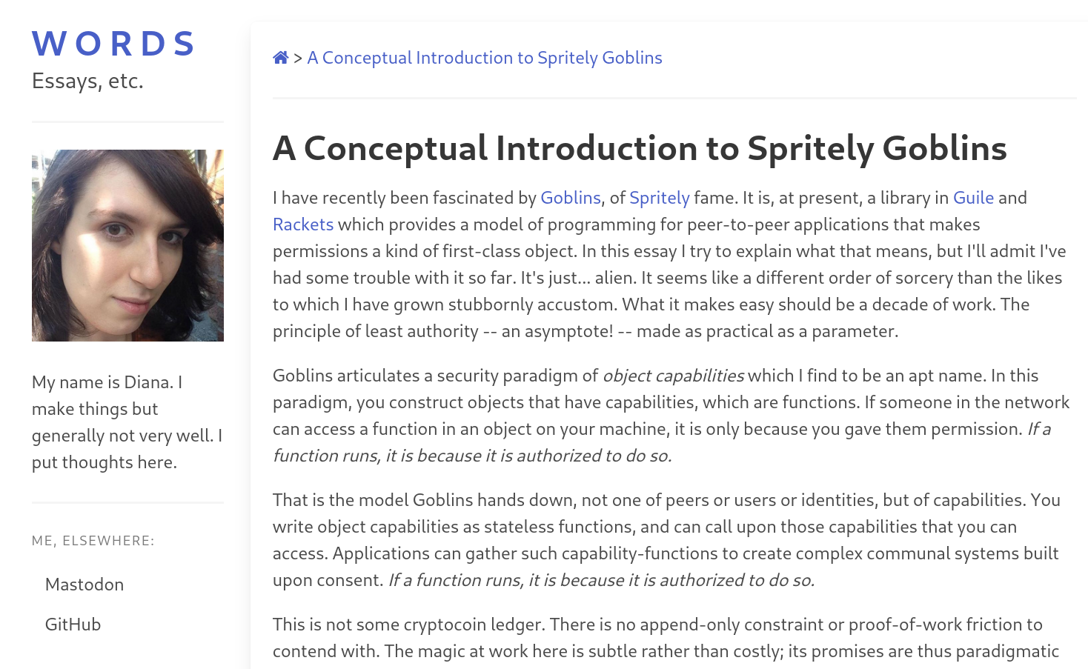
Papers, Platforms, Developers (Oh My)
Notes:
Papers,
Platforms
Developers,
OH MY!

Slide 23
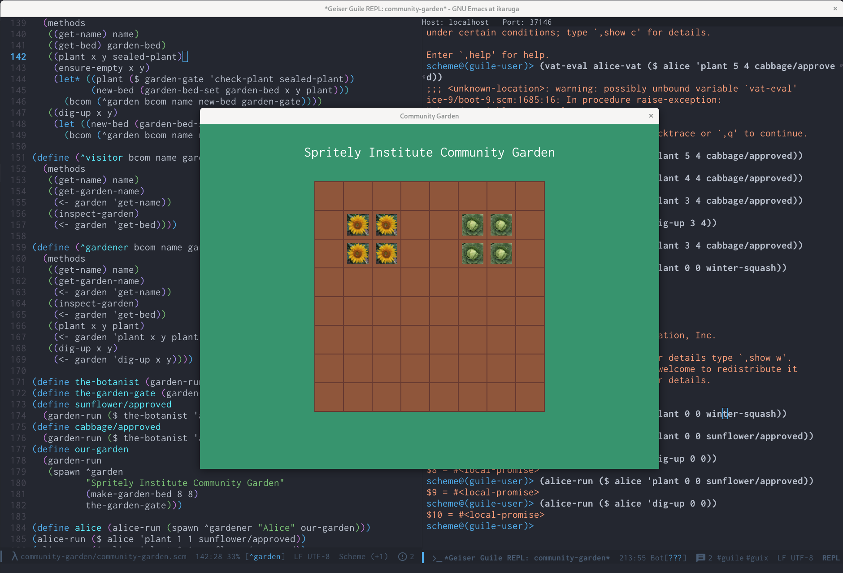
Papers, Platforms, Developers (Oh My)
Notes:
Papers,
Platforms
Developers,
OH MY!

Slide 24
We’re an Institute!
Let’s share research!
Notes:
[Christine] But building this right is going to take a lot of work. And that’s why we need your help.

Slide 25
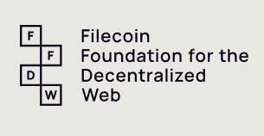
Our Supporters
Notes:
But building this right is going to take a lot of work by a lot of people and organizations. This are our first supporters…

Slide 26
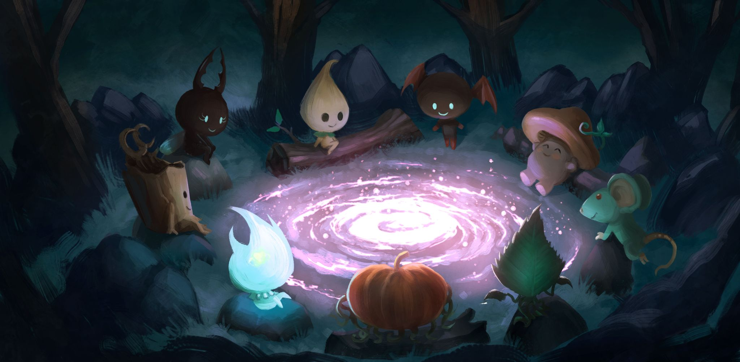
Let’s Re-Decentralize
Community Together!
randy@spritely.institute
christine@spritely.institute
Notes:
[Christine] We have an opportunity here to make a new foundation for the internet, one that’s healthier for people and for communities. The time and place are now. We hope we can work together to make it happen!

Slide 27
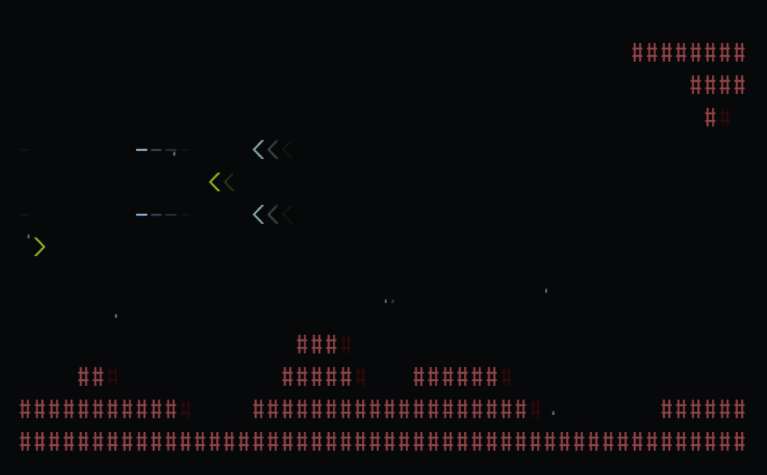
Papers, Platforms, Developers (Oh My)
Notes:
Papers,
Platforms
Developers,
OH MY!

Slide 28
Distributed Network Architecture
Apps and Services
Discovery
Storage
Finance
Communities
Membership
Models
Threads &
Posts
Governance &
Moderation
People
Identity &
Authentication
Profiles &
Attributes
Filters & Subscriptions
Consent &
Capabilities
Cooperating Mutually Suspicious Distributed Objects
Capabilities
Trust Frameworks
Persistence
Connections
Notes:
[Randy] At the core is strict support for distributed objects that communicate exclusively through granted capabilities, with trust frameworks provided to assist with making good (but still revocable) decisions and other core services such as safe persistence and connection management.
<click>
People-related objects are built on top of this, expressing identities and profiles while managing how they share information, connect to one another, and filter what they receive.
<click>
Once you have people and connections, you can build communities. This layer includes membership, governance, and moderation models as well as community-specific structures such as threads and posts.
<click>
With all of these in place, the “top” layer adds objects for enabling applications and services - such as support for discovery, distributed storage, and finance, along with many others…
All open source - free to all forever.

Slide 29
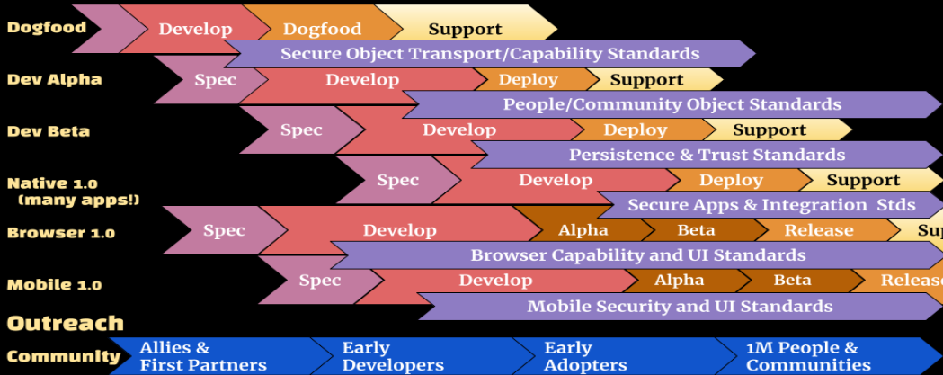
SNCI Milestones (Fully Funded) 2022-2025
Q3 Q4 Q1 Q2 Q3 Q4 Q1 Q2 Q3 Q4 Q1 Q2 Q3 Q4
2022 2023 2024 2025
Notes:
[Do we want this?]

Slide 30
The Agency: Client & Server
The Agency
Apps and Services
Communities
People
Cooperating Mutually Suspicious Distributed Objects
Notes:
[Christine]
The software that holds this all together is something we call The Agency -
It is an execution environment where there’s no distinction between client or server .
Your agency doesn’t represent the needs or whims of some external gatekeeper… it runs on behalf of, and represents, you.

Slide 31
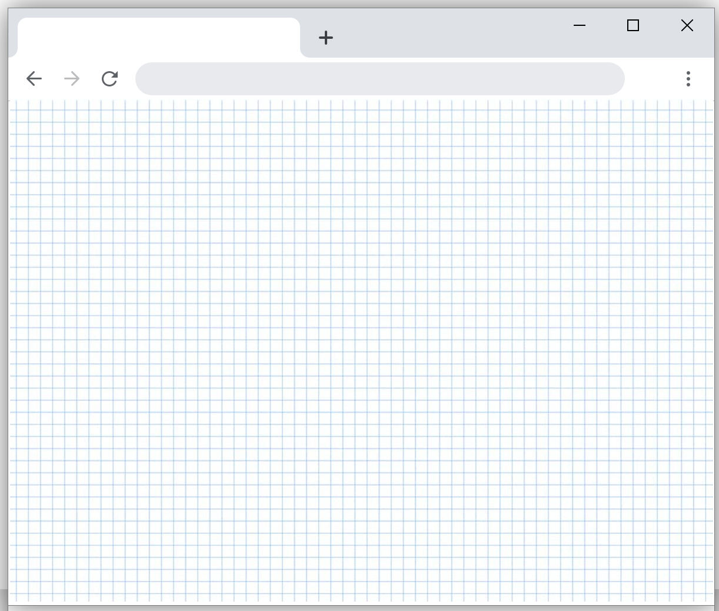
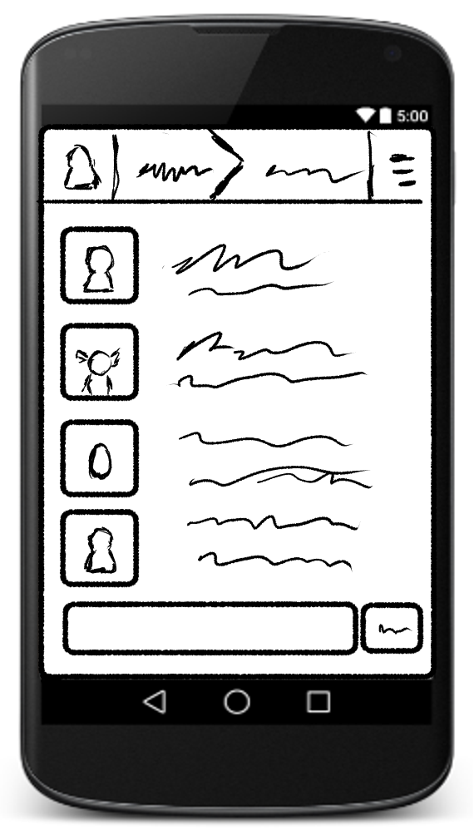
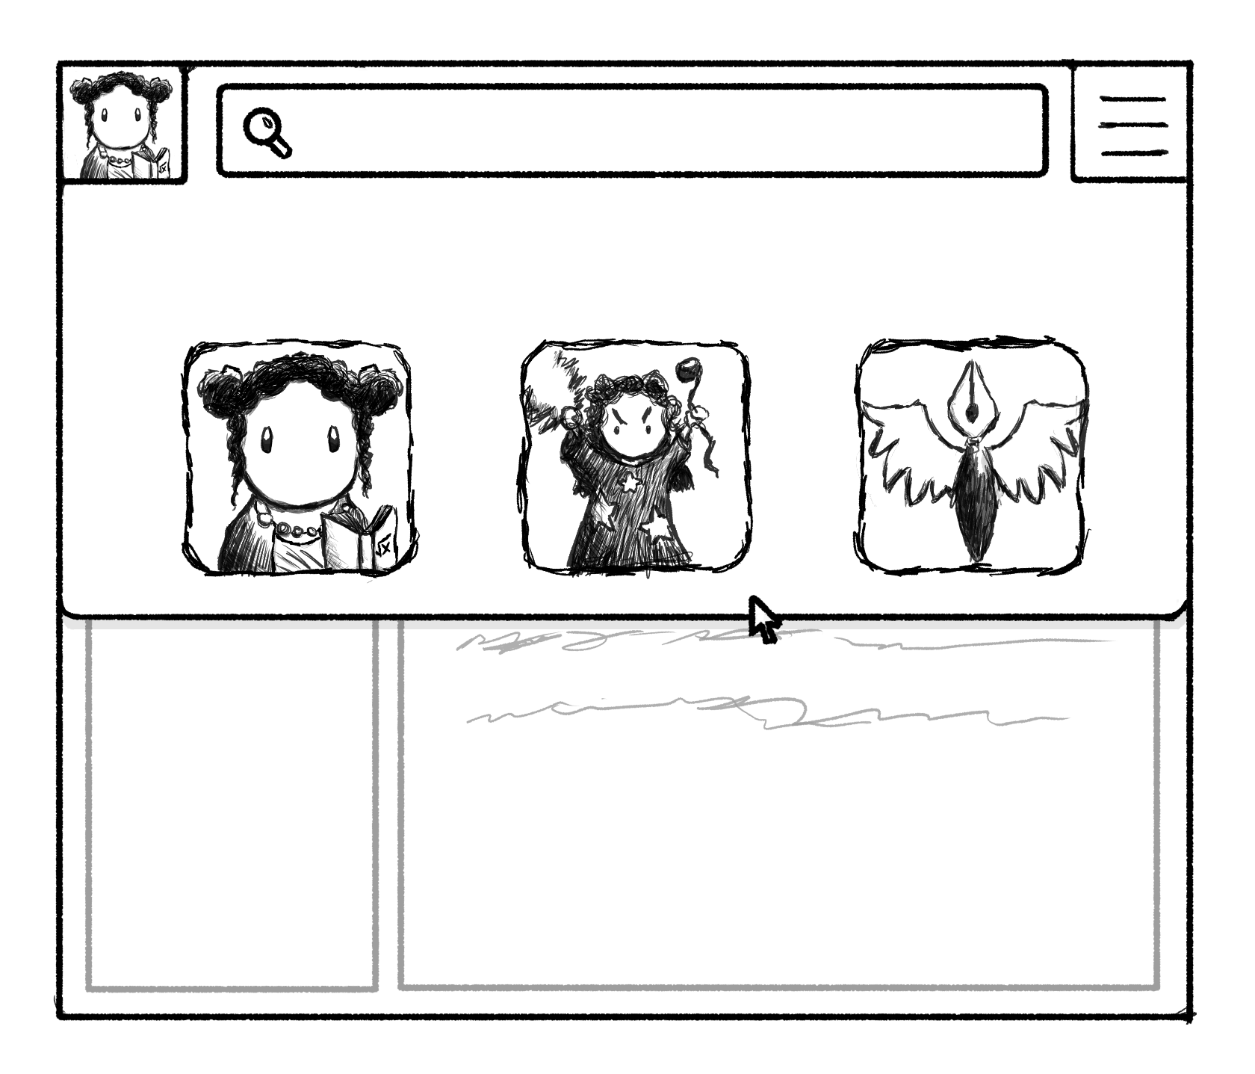
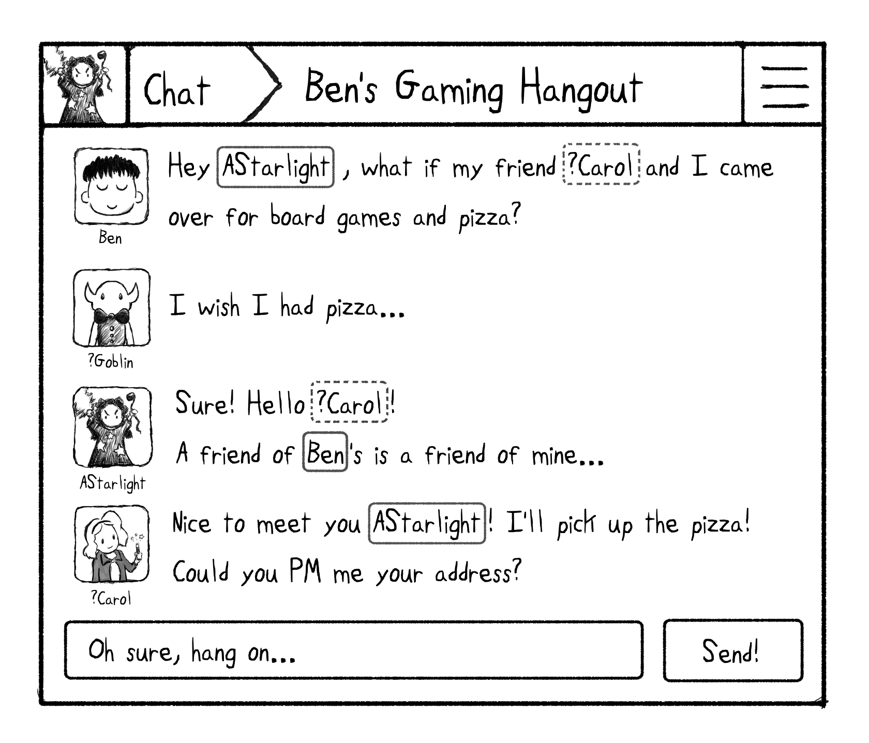
The Agency
Notes:
Here we can see two manifestations of The Agency, as a “desktop” style multi-windowed software, representing multiple contexts (here itself embedded as a browser web application) and also as a mobile application that displays contexts one at a time.

Slide 32
But what we need to enable fully-user controlled secure communities requires so much more than federated messaging.

Slide 33
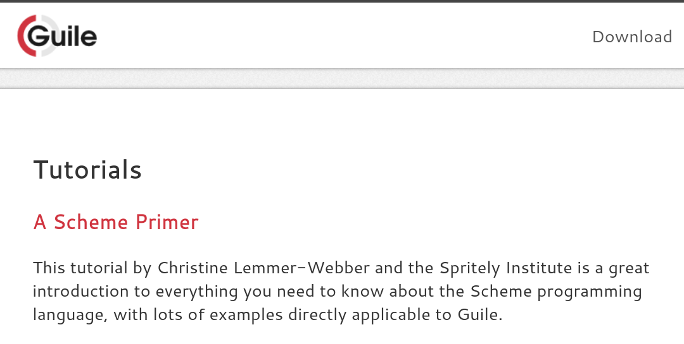
Papers, Platforms, Developers (Oh My)
Notes:
Papers,
Platforms
Developers,
OH MY!

